Slide 1

Generative Adversarial Network based Image Super-Resolution to Enhance the shadow-less Image
Jishnu P
CB.EN.P2AID19017
M Tech (AID) 2019 - 2021 Batch
Guided By:
Dr. Rajathilagam B
Associate Professor
Department of Computer Science and Engineering

Slide 2
contents
Methodology
Proposed Architecture
Proposed Algorithm
Results
Where to apply this model?
Conclusion and Future Directions
References
Problem Statement - Phase 1
Limitations and Enhancements
Problem statement - Phase 2
Motivation
Literature Survey
Objectives of proposed work
Novelty of proposed Approach
Dataset Information
Preprocessing

Slide 3
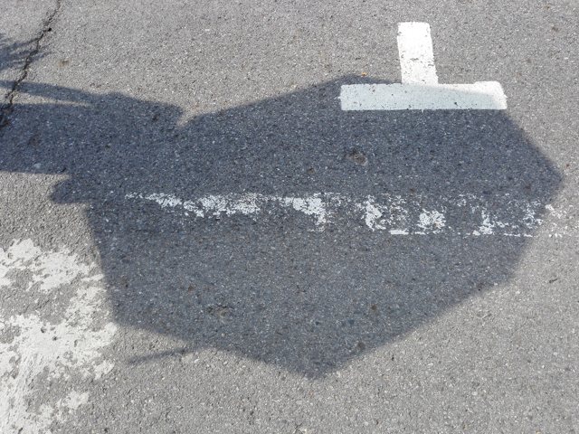
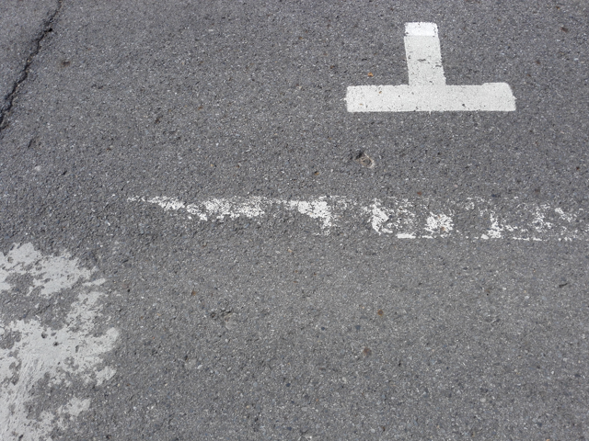
Problem statement - phase 1
Objective : To propose GAN based Shadow removal architecture which generates higher quality shadowless images(Figure 2) for the given shadowed input images(Figure 1).
Title : “Enhanced Shadow Removal for Surveillance Systems “
Fig 1 : Shadowed image
Fig 2 : Shadow-less image

Slide 4
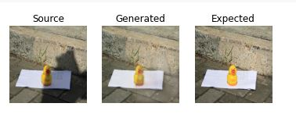
limitations and enhancements
Limitations :
* Only shadow removal performed
successfully.
* Information restored in the shadowed
region need to be enhanced(Figure 3).
Enhancements : Introducing image Super-Resolution module in the shadow removal pipeline to improve the quality of shadow-less image before applying higher level computer vision tasks.
Fig 3: Sample output of GAN based shadow removal model on SRD dataset

Slide 5
Problem statement - phase 2
Objective : To develop an Image Super-Resolution model with Generative Adversarial Network(GAN) which can improve the quality of the shadow-less image and improve the performance of higher level computer vision tasks in surveillance systems.
Applications :
Shadow removal can be used as the preprocessing operation for various surveillance applications like wild animal detection, Plant leaf detetion, etc..
Shadow removal filter can be used in cameras to remove shadows in the image and enhance the picture.

Slide 6
Challenges and Motivation
The shadow detection phase has greatly improved , but the field of shadow removal has been difficult because it needs to be restored after removing the shadow.
The shadow removed region seems to be poor in quality compared to the non-shadow region in the shadow-less image.
After the introduction of Generative Adversarial Networks (GAN) in 2014[1], the computer vision domain has taken leap at various tasks.
GAN based Image Super-Resolution method is efficient for enhancing the low quality images.

Slide 7
literature survey
Table 1: Literature survey
Title | Techniques and Datasets | Results
“Image Super-Resolution Using Deep Convolutional Networks ” SRCNN[2] (2016) | Convolutional Neural Network consisting of only 3 convolution layers: patch extraction and representation, non‑linear mapping and reconstruction. Datasets : set 14, set 5, BSD 100 | PSNR =25.70 dB SSIM = 0.7184 *First deep learning method to outperform all the traditional methods.
“Accurate Image Super-Resolution Using Very Deep Convolutional Networks”[3] (2016) | - Similar structure as SRCNN with depth = 20 Dataset : BSD 100, set 14, set 5 | PSNR = 27.29 dB SSIM = 0.725 * More accurate in retaining the high frequency components in the resultant image.

Slide 8
literature survey
Table 1: Literature survey
Title | Techniques and Datasets | Results
“Photo-Realistic Single Image Super-Resolution Using a Generative Adversarial Network”[4] (2017) | - Generative Adversarial networks with perceptual loss Dataset : BSD 100, set 14, set 5 | PSNR = 25.16 dB SSIM = 0.6688 * Finer details are missing in the resulting image and not used for surveillance applications
“ESRGAN: Enhanced Super-Resolution Generative Adversarial Networks”[5] (2018) | Introduce the Residual-in-Residual Dense Block (RRDB) without batch normalization as the basic network building unit. Dataset : BSD 100 | PSNR = 27.66 dB RMSE = 15.15 * Improved the image quality compared to the SRGAN[4]

Slide 9
literature survey
Table 1: Literature survey
Title | Techniques and datasets | Results
"Generative Adversarial Network for Image Super-Resolution Combining Texture Loss"[6] (2020) | -Generative Adversarial Network(GAN) Introduced dense block to deepen the structure of the the generator. VGG19 architecture adopted in discriminator. Dataset: BSD 100 | PSNR= 27.99 dB SSIM=0.778 * Imroved image quality compared to the ESRGAN[5] and reconstruct more realistic images with enhanced texture details.

Slide 10
objectives of the proposed work
Use Generative Adversarial Network for enhancing the quality of the given low resolution image.
Use this image super-resolution module with the shadow removal module to enhance the quality of the shadow-less image. - “Enhanced Shadow Removal module”
Evaluate the performance of the proposed model using the evaluation metrics and compare with existing models.

Slide 11
Novelty of proposed approach
Ensuring the quality of the shadow free image generated by the shadow removal module by introducing the super-resolution module in the pipeline.
Introducing enhanced architecture for generator and discriminator and Combined loss for GAN training.

Slide 12
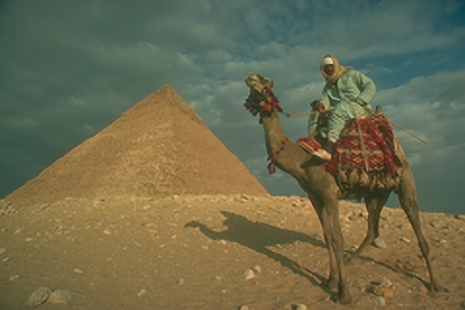
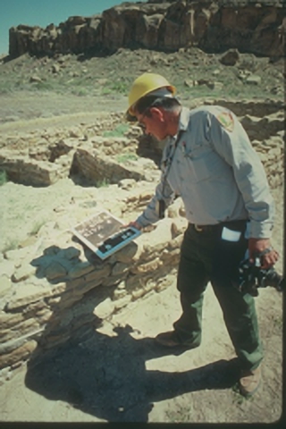
DATASET information
BSD 100 (Berkeley Segmentation Dataset) is a dataset used frequently for image denoising and super-resolution.
Composed of 1100 large variety of images(320 *480 pixels) ranging from natural images to object-specific such as plants, people, food.
Size = 575 MB
file format = .png
Fig : 5 Sample images in BSD 100 dataset

Slide 13
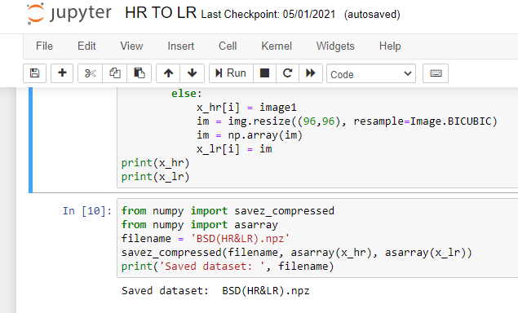
Preprocessing
Low Resolution(LR) images are generated by applying BICUBIC interpolation technique on High Resolution (HR) images.
Saved the dataset as BSD(HR&LR).npz
Fig : 6 Preprocessing Implimentation

Slide 14
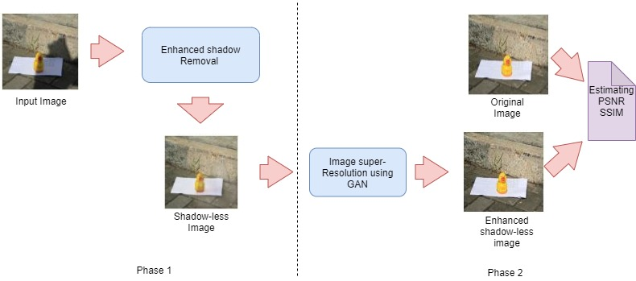
Methodology
Fig 7 : Block diagram of the project

Slide 15
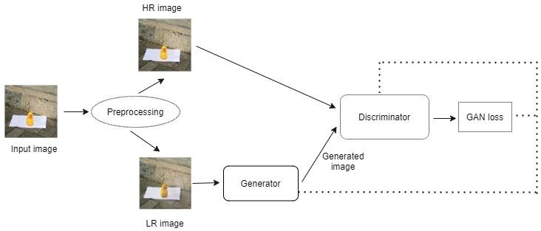
PRoposed Architeture
Fig 8: Basic architecture of the Image Super-Resolution module

Slide 16
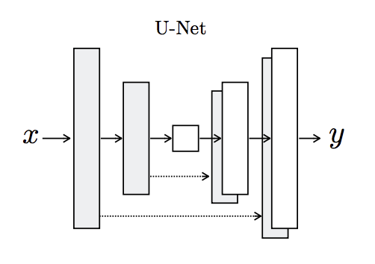
proposed architecture
The generator is an encoder-decoder model using a U-Net architecture.
The encoder and decoder of the generator contains convolutional, batch normalization and activation layers.
Fig 9 : U-Net architecture
Source : https://arxiv.org/abs/1505.04597

Slide 17
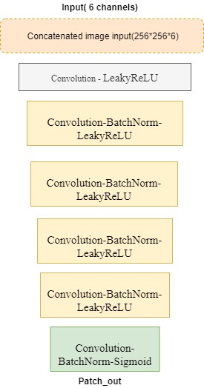
proposed Architecture
Fig 10: Architecture of Discriminator

Slide 18
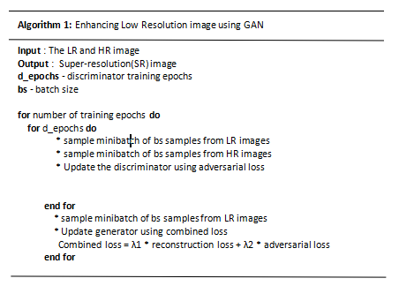
PRoposed Algorithm
Fig 11: Proposed algorithm,

Slide 19

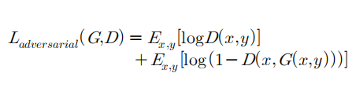
proposed algorithm
Generator loss is calculated as the Combined Loss
Combined loss = λ1 * reconstruction loss + λ2 * adversarial loss λ1,λ2 - 100,1
The reconstruction loss is the loss function between the generated fake image and the shadow-less image
Adversarial loss (Binary Cross Entropy loss)
x - shadowless image
y - shadowed image

Slide 20
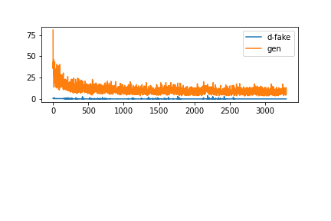
results
Generator and Discriminator Training Loss Curves
Loss
Epochs
Fig 12: Generator and discriminator loss curve

Slide 21
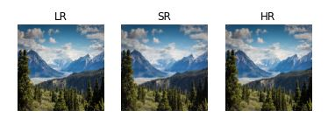
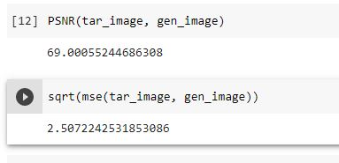
results- Image Enhancement
Fig 14 : Image Enhancement module output and metrics

Slide 22
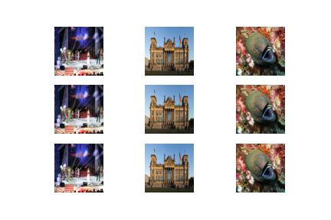

results - Image enhancement
LR
SR
HR
Fig 15 : Image enhancement module output and corresponding metrics

Slide 23
Results -Image enhancement
Table 2: Comparing with standard algorithms
Model | PSNR(dB) | SSIM
SRGAN[7] | 25.16 | 0.668
ESRGAN[8] | 27.66 | .......
GAN combining Texture loss[6] (2020) | 27.99 | 0.778
Our model | 72.67 | 0.798

Slide 24
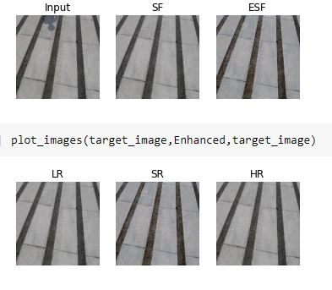
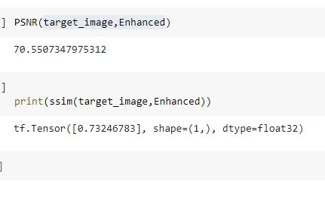
results - Shadow Removal
Fig 16 : Sample Output of proposed model SF-Shadow-free, ESF-Enhanced shadow-free images respectively

Slide 25
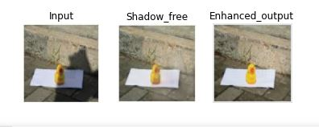
results - Shadow Removal
Fig 17 : Output of Enhanced Shadow removal model

Slide 26
Enhanced shadow removal module
Table 3: Comparing with standard algorithms
Model | RMSE | PSNR | SSIM
ST-GAN[7] | 7.47 | 30.66 | .....
RIS-GAN[8] | 6.67 | 31.64 | .....
Our model | 1.997 | 53.38 | 0.722

Slide 27
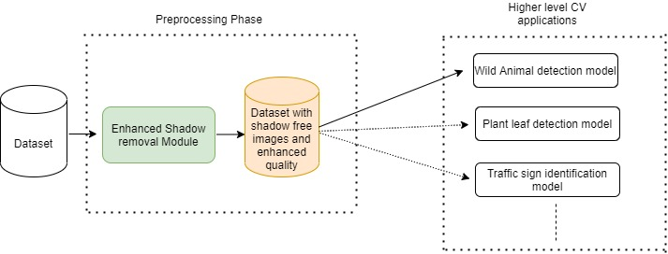
Where to Apply this model?
Fig 18 : Application of proposed model

Slide 28
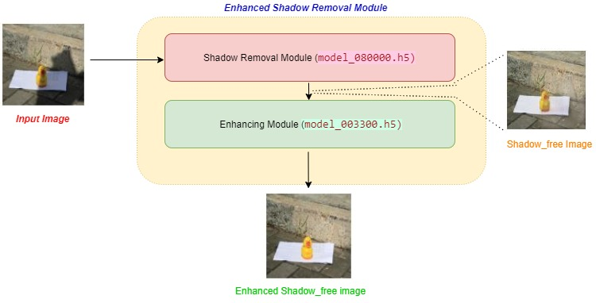
Enhanced shadow removal module
43 sec
Fig 19 : Application of proposed model

Slide 29
conclusion & future Directions
The proposed model for the Image enhancement module works well and shows promosing results compared to the standard algorithm.
Our final module for shadow removal not only removes the shadow but also guaranties high quality shadow free images for further high level Computer Vision Applications.
Genetic algorithm can be introduced for tuning the hyper parameters as a future enhancement.

Slide 30
PUBLICATION STATUS
3rd International Conference on Innovative Data Communication Technologies and Application(ICIDCA 2021)
Accepted. Conference date - 20/08/2021 to 21/08/2021

Slide 31
References
[1]Ian J. Goodfellow, Jean Pouget-Abadie, Mehdi Mirza, Bing Xu, David Warde-Farley, Sherjil Ozair, Aaron Courville, Yoshua Bengio, “Generative Adversarial Networks”, International Conference on Neural Information Processing Systems, 2014, https://arxiv.org/abs/1406.2661
[2]C. Dong, C. C. Loy, K. He and X. Tang, "Image Super-Resolution Using Deep Convolutional Networks," in IEEE Transactions on Pattern Analysis and Machine Intelligence, vol. 38, no. 2, pp. 295-307, 1 Feb. 2016, doi: 10.1109/TPAMI.2015.2439281.
[3]J. Kim, J. K. Lee and K. M. Lee, "Accurate Image Super-Resolution Using Very Deep Convolutional Networks," 2016 IEEE Conference on Computer Vision and Pattern Recognition (CVPR), 2016, pp. 1646-1654, doi: 10.1109/CVPR.2016.182.
[4]Christian Ledig, Lucas Theis, Ferenc Huszar, Jose Caballero, Andrew Cunningham, Alejandro Acosta, Andrew Aitken, Alykhan Tejani, Johannes Totz, Zehan Wang, Wenzhe Shi, “Photo-Realistic Single Image Super-Resolution Using a Generative Adversarial Network” , Computer Vision and Pattern Recognition , 2017,https://arxiv.org/abs/1609.04802v5

Slide 32
references
[5]Wang X. et al. (2019), “ ESRGAN: Enhanced Super-Resolution Generative Adversarial Networks.” In: Leal-Taixé L., Roth S. (eds) Computer Vision – ECCV 2018 Workshops. ECCV 2018,Springer, Cham. https://doi.org/10.1007/978-3-030-11021-5_5
[6]Jiang Y, Li J. Generative Adversarial Network for Image Super-Resolution Combining Texture Loss. Applied Sciences. 2020; 10(5):1729. https://doi.org/10.3390/app10051729
[7]Jifeng Wang, Xiang Li2, Jian Yang, “Stacked Conditional Generative Adversarial Networks for Jointly Learning Shadow Detection and Shadow Removal”,CVPR 2017, https://doi.ieeecomputersociety.org/10.1109/CVPR.2018.00192
[8]Ling Zhang,1 Chengjiang Long,2∗ Xiaolong Zhang,1 Chunxia Xiao3, “RIS-GAN: Explore Residual and Illumination with Generative Adversarial Networks for Shadow Removal”, AAAI 2020,https://doi.org/10.1609/aaai.v34i07.6979

Slide 33
THANK YOU

Slide 34
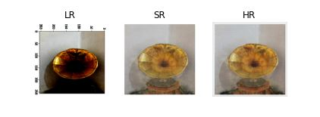
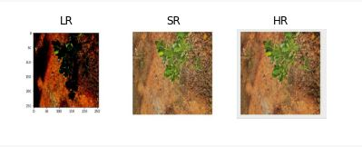
APPENDIX
Fig 18: Sample Output of the enhanced shadow removal module
Fig 19 : sample output of enhanced shadow removal module

Slide 35
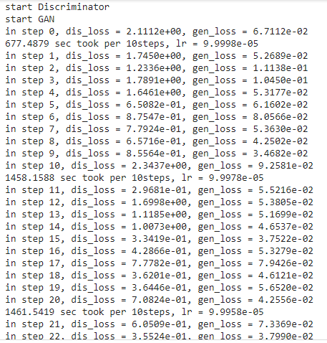
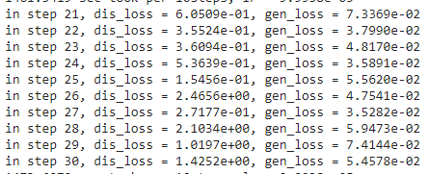
APPENDIX
Fig 13 : Model trainig logs

